Slide 1

FITIFY REVIEW

Slide 2
TABLE OF CONTENTS
What is Fitify?
System Requirements
Data Collection
Data Privacy Concerns
Pros and Cons
Cost

Slide 3
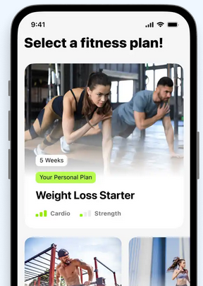
WHAT IS FITIFY?
Personalized home workout app
No gym equipment required
900+ exercises
Personalized training plans (paid)
Millions of downloads
4.7 star rating (+270K reviews)

Slide 4
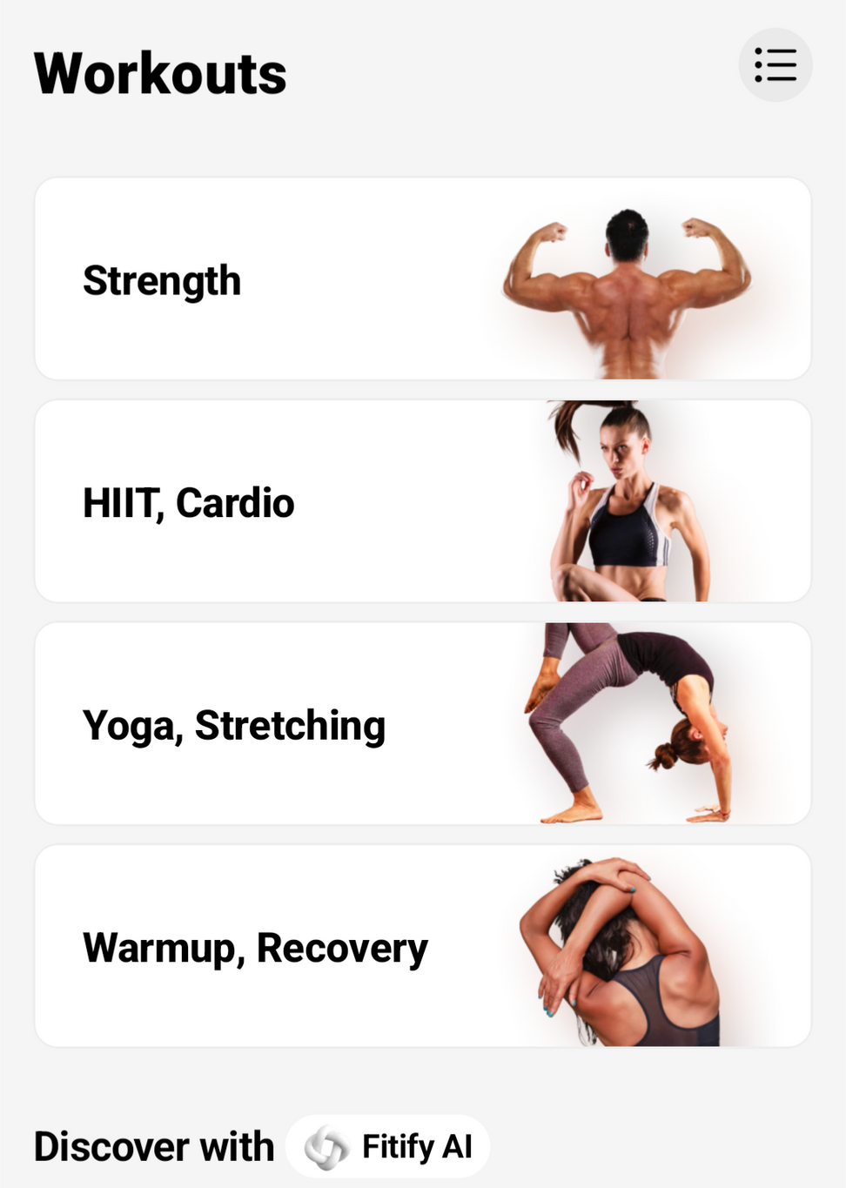
TYPES OF WORKOUTS
Strength
HIIT
Cardio
Functional Training
Nutrition
Recovery
Stretching
Yoga
Rolling

Slide 5

SYSTEM REQUIREMENTS
Fitify Workouts s.r.o
App Version 1.91.1
Storage Required
~280MB
Apple
iPhone: iOS 16.0 or later
iPad: iOS 16.0 or later
mac: macOS 13.0 or later AND Apple M1 chip
apple watch: watchOS 8.0 and later
Android
Android 10 or later
Huawei
Unknown

Slide 6
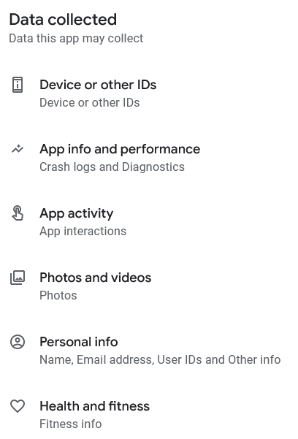
DATA COLLECTION
Fitify retains all data you disclose within the app
They own all content you upload to the app (videos, photos, comments, reviews, etc)
They reserve the right to use your content as they wish

Slide 7

DATA PRIVACY CONCERNS
Data collected to improve user experience
Utilized with 3rd parties such as Facebook Advertising (Facebook now owns the data), Google Analytics, etc.
Must abide by laws of local jurisdictions

Slide 8
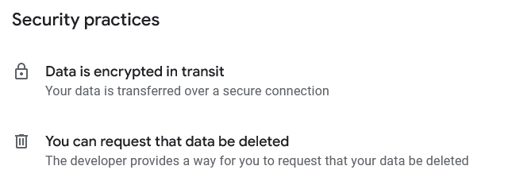
DATA PRIVACY CONCERNS

Slide 9
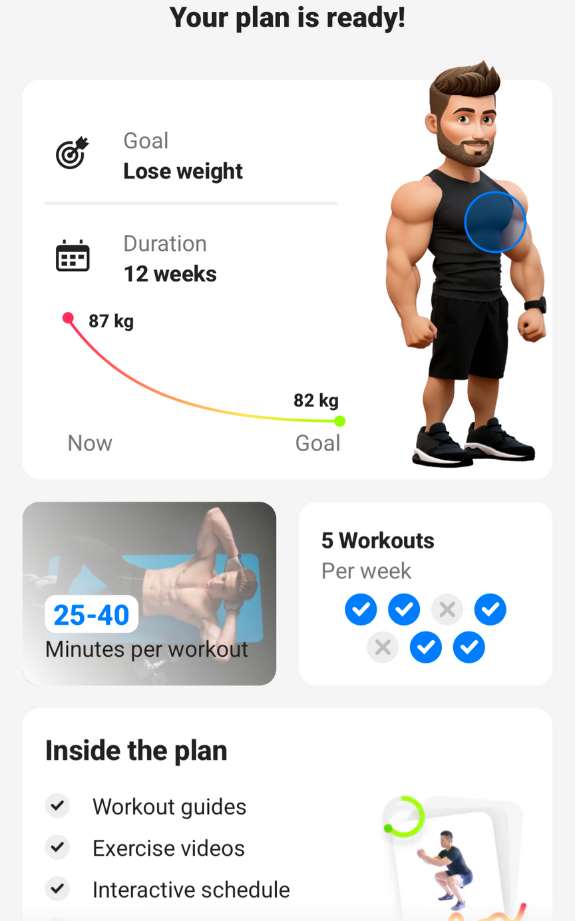
PROS AND CONS
UI is clean

Slide 10
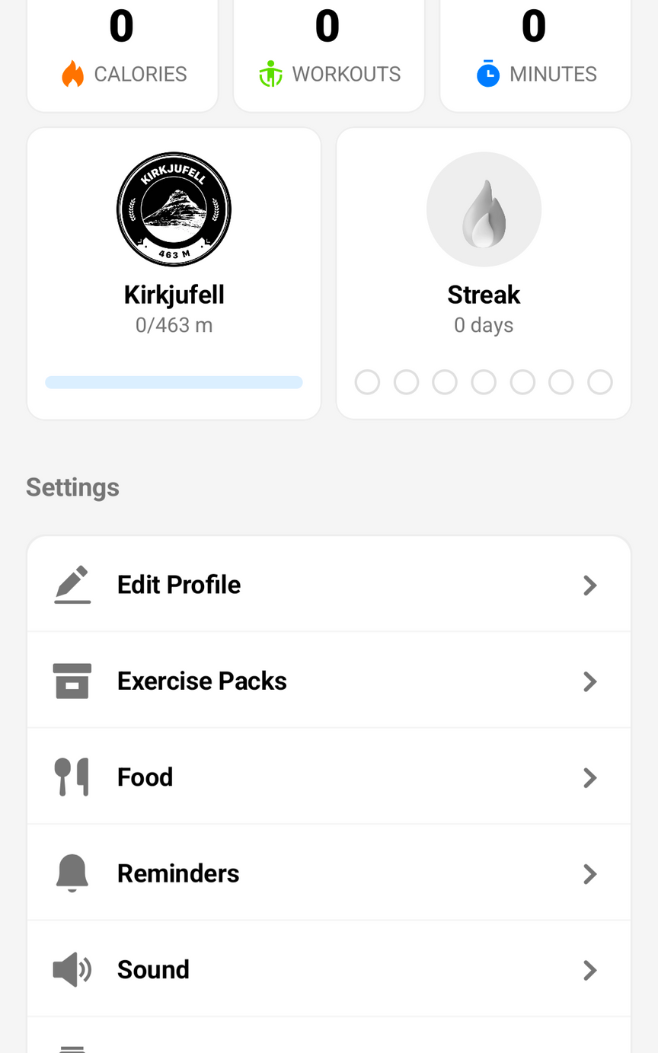
PROS AND CONS
UI is clean
Easy to navigate

Slide 11
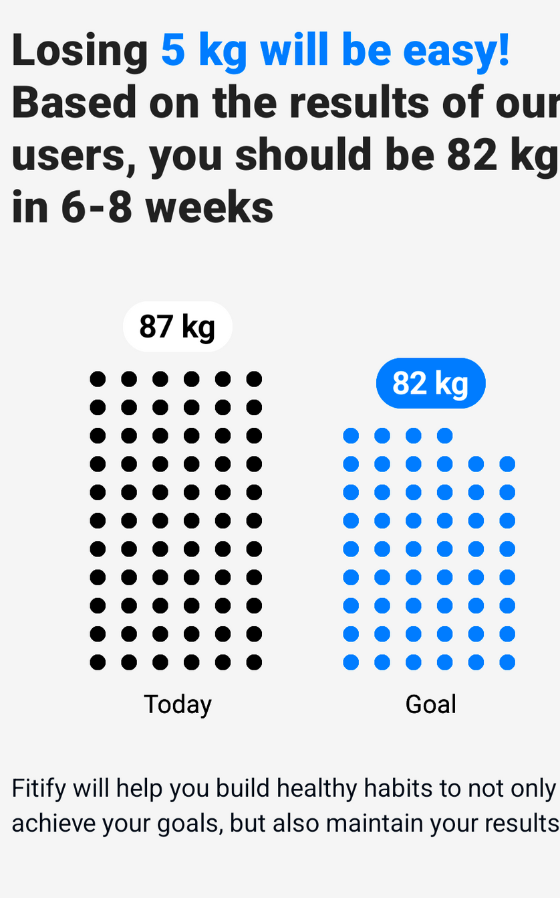
PROS AND CONS
UI is clean
Easy to navigate
Helps set clear goals

Slide 12
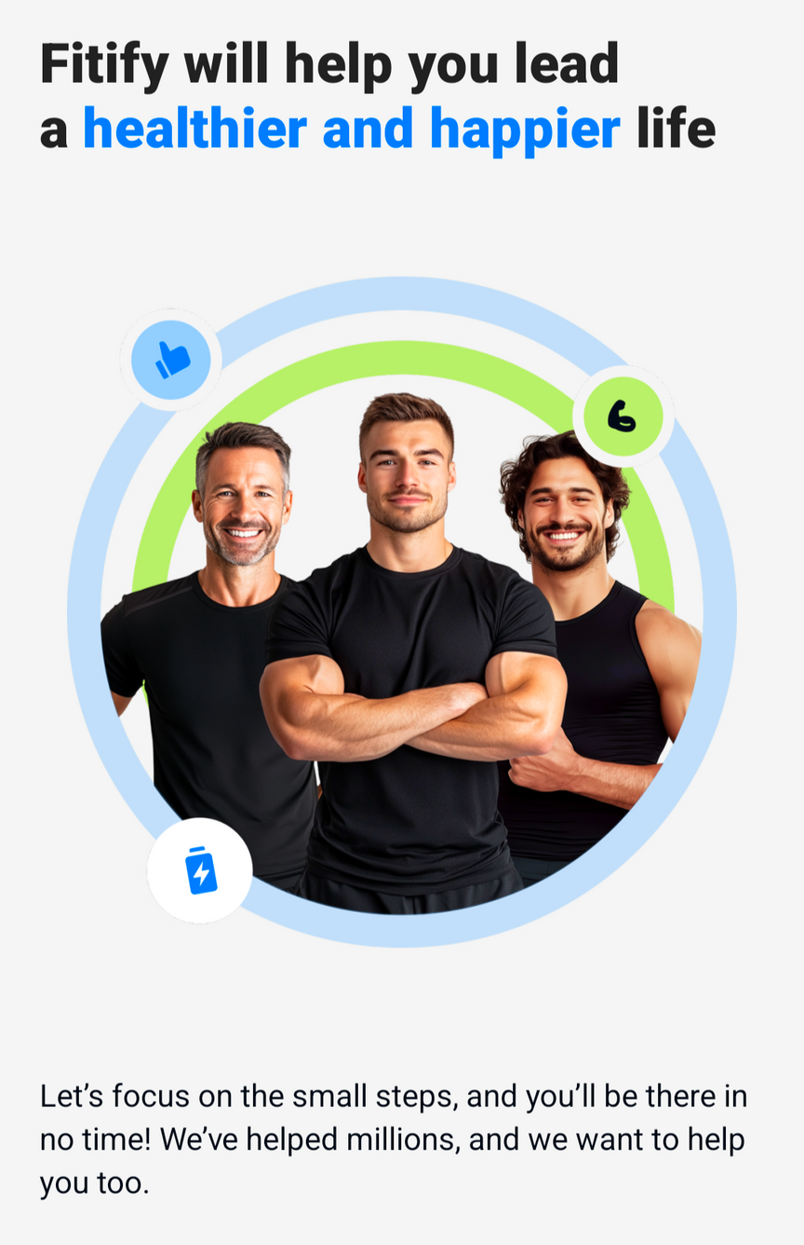
PROS AND CONS
UI is clean
Easy to navigate
Helps set clear goals
Motivating! “just 15 min of activity per day...”

Slide 13
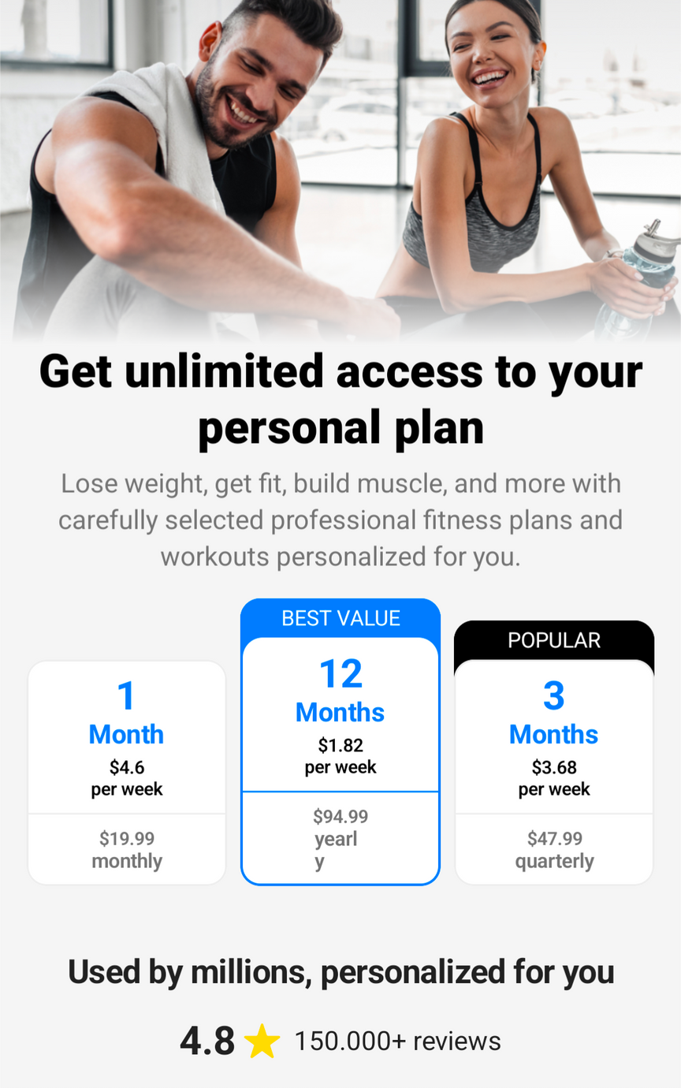
PROS AND CONS
Almost everything behind paywall

Slide 14
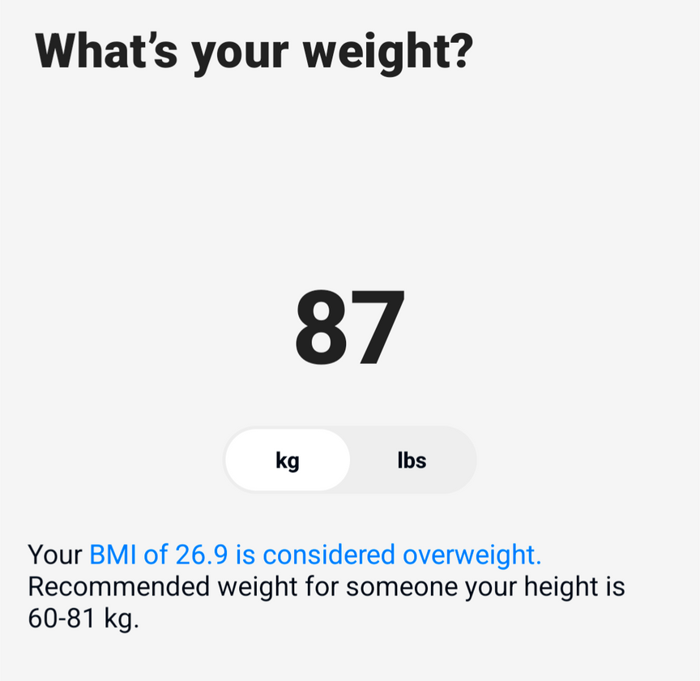
PROS AND CONS
Almost everything behind paywall
BMI to gauge health status

Slide 15
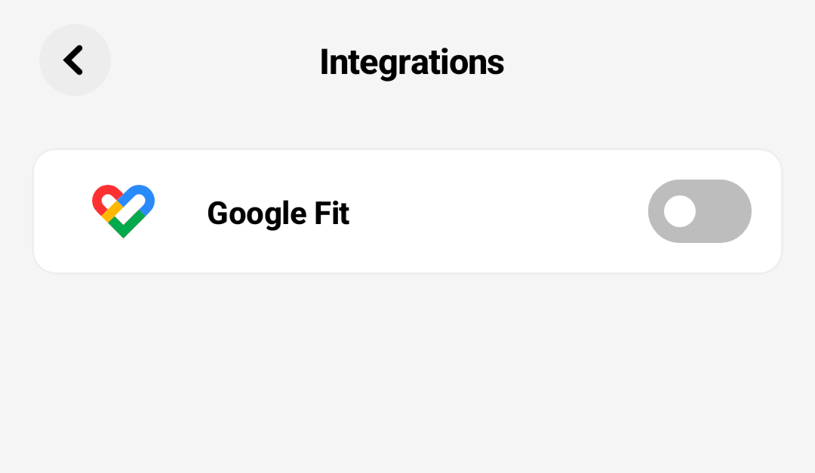
PROS AND CONS
Almost everything behind paywall
BMI to gauge health status
Minimal integration (also apple watch)

Slide 16
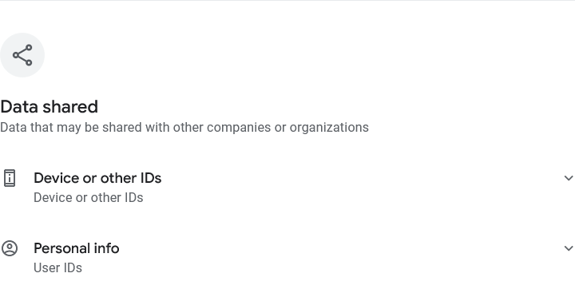
PROS AND CONS
Almost everything behind paywall
BMI to gauge health status
Minimal integration (except apple watch)
They own all data and can do what they want with it

Slide 17
COST
Free version available (highly limited access)
Cheapest option ~$95
No in-app purchases
Can cancel and restore subscription at any time

Slide 18
THANK YOU!

